Slide 1
Metal forming

Slide 2
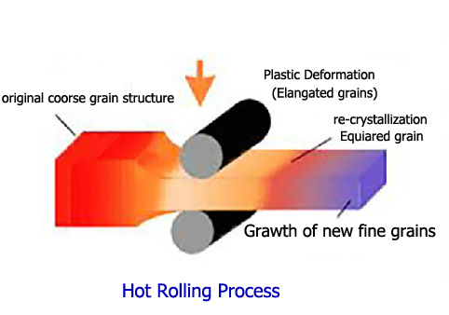
Rolling

Slide 3
Parameters in Rolling
Volume of ingots
Velocity of strip
Surface speed
Pressure
Roll diameters
Velocity of rollers

Slide 4
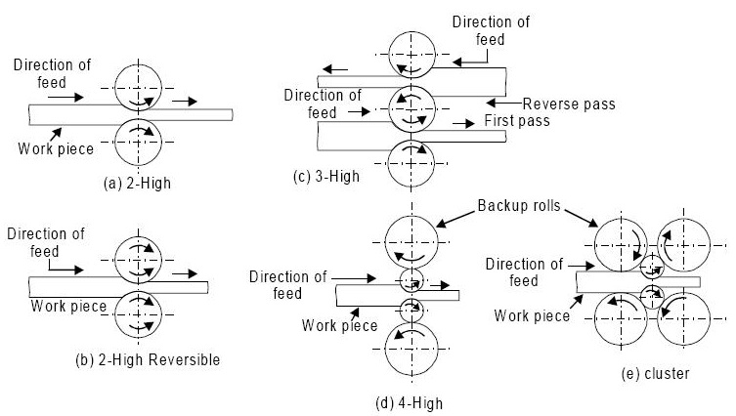
Rolling stand arrangements

Slide 5
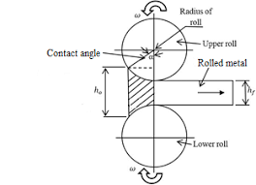
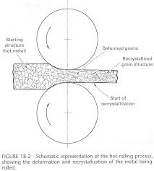

Slide 6
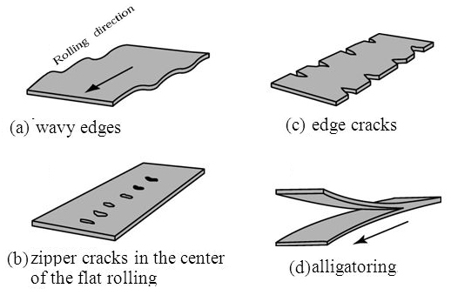
Defects in rolling

Slide 7
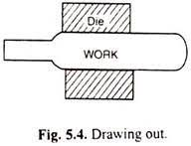
Forging
Drawing out: Metal is elongated with a reduction in cross-sectional area
Force is applied in a direction perpendicular to length axis
Upsetting: To increase cross-sectional area at the expense of its length.

Slide 8
Classification of forging
Smith forging
Drop
Press forging
Machine forging

Slide 9
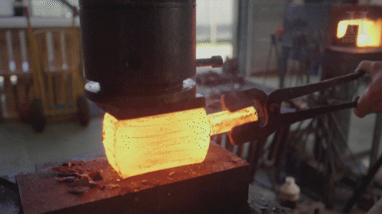
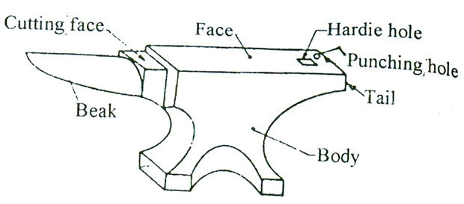
Smith forging
Heating the block
Beating it over anvil

Slide 10
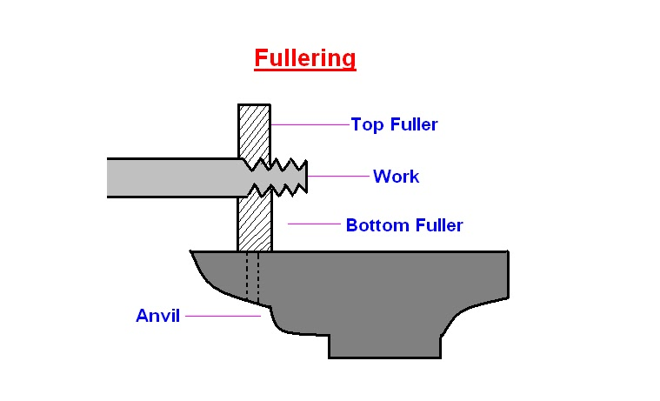
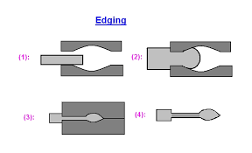
fullering
Edging

Slide 11
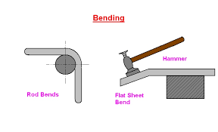
Bending
Blocking impression

Slide 12
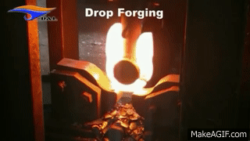
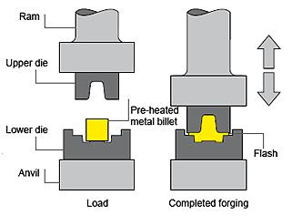
Drop forging
Uses closed Impression dies(Drop hammers are used)

Slide 13
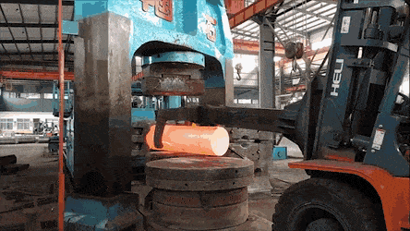

Slide 14
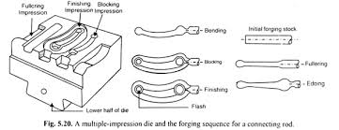
Stages in forging

Slide 15
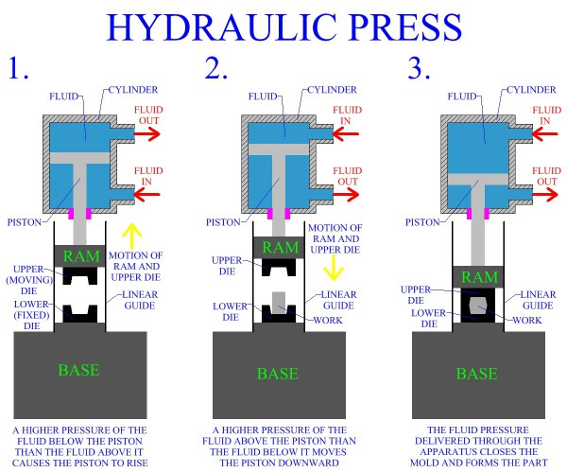
Press forging
Metal is shaped by continuous Squeezing action by means of hydraulic presses
Material gets uniformly deformed through out its entire depth

Slide 16
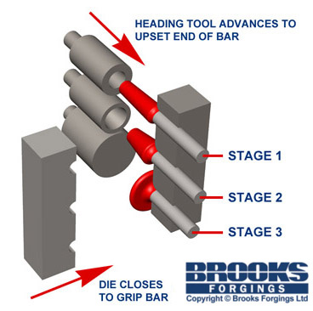
Machine forging

Slide 17
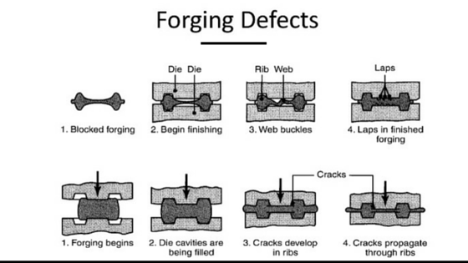
Forging defects
Unfilled sections
Cold shut
Scale pits
Die shifts
Flakes
Improper Grain flow

Slide 18
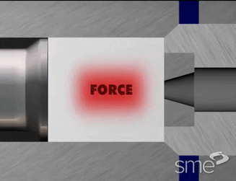
Extrusion

Slide 19
Classification of extrusion
Hot and backward extrusion
Cold extrusion

Slide 20
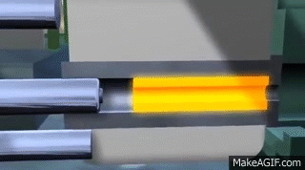
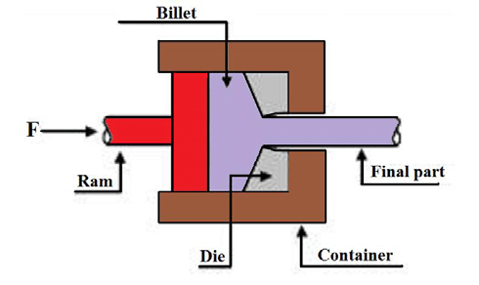
Hot extrusion

Slide 21
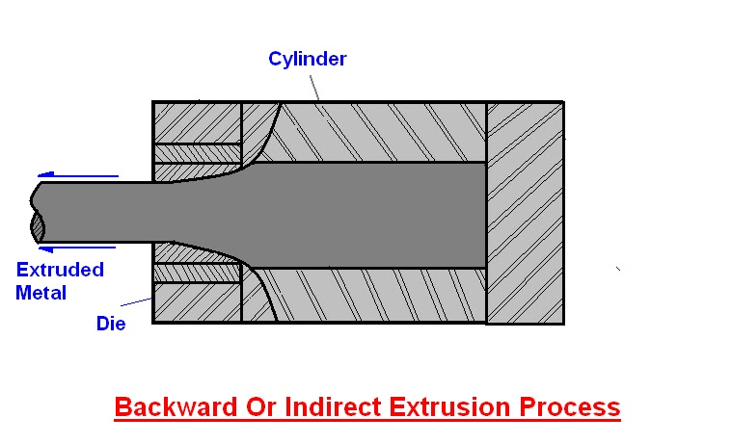
Backward hot extrusion

Slide 22
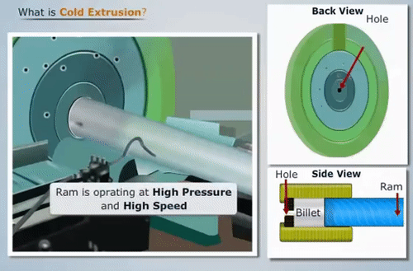
Cold extrusion

Slide 23
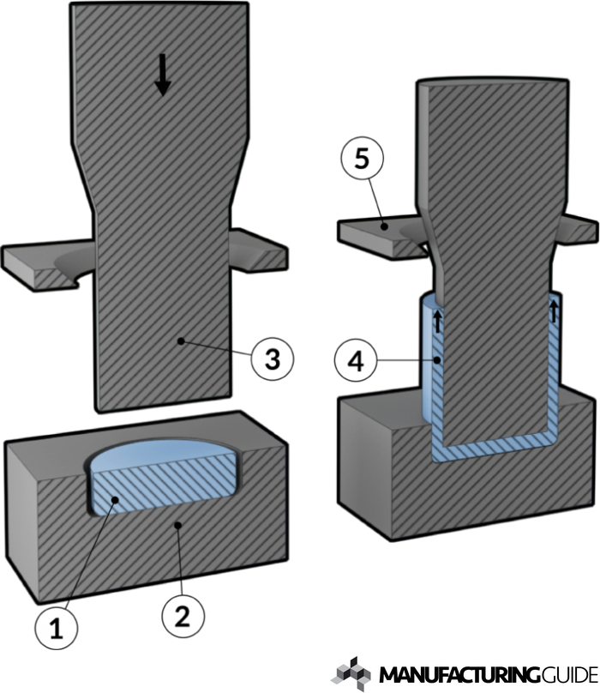
Impact extrusion

